Slide 1


Noida Institute of Engineering and Technology | 2026
Stock Price Prediction. Using deep learning
Student Name :Sonu Kumar
Project Group: 199
Roll Number : 2301331539013
Programme : B.Tech (Computer Science & Engineering - AI & ML)
School Name : School of Emerging Technologies
Study Mode : Regular
Supervisor : MS.Mohini Chakarverti,Assistant Professor

Slide 2
Noida Institute of Engineering and Technology | 2026
Introduction
Challenges in Stock Market
Project Objectives
Technologies Used
System Architecture
Data Processing Pipeline
Technical Indicators Used
Deep Learning Model: LSTM
AI Decision Logic

Slide 3

Noida Institute of Engineering and Technology | 2026
Stock Price Prediction Using Deep Learning
AI-Based Stock Analysis & Recommendation System

Slide 4

Noida Institute of Engineering and Technology | 2026
Challenges in Stock Market
Stock market prediction is complex and uncertain
Manual analysis is time-consuming
Beginners struggle with decision making
Our Solution
AI-based stock prediction system with interactive dashboard

Slide 5
Noida Institute of Engineering and Technology | 2026
Project Objectives
01
02
03
Predict Future Prices
Generate Signals
Visualize Trends
Use Deep Learning to forecast stock prices
Provide BUY/SELL/HOLD recommendations
Display stock trends and technical indicators
04
05
Build Dashboard
Data Support
Create user-friendly interface
Handle both CSV data and live data

Slide 6
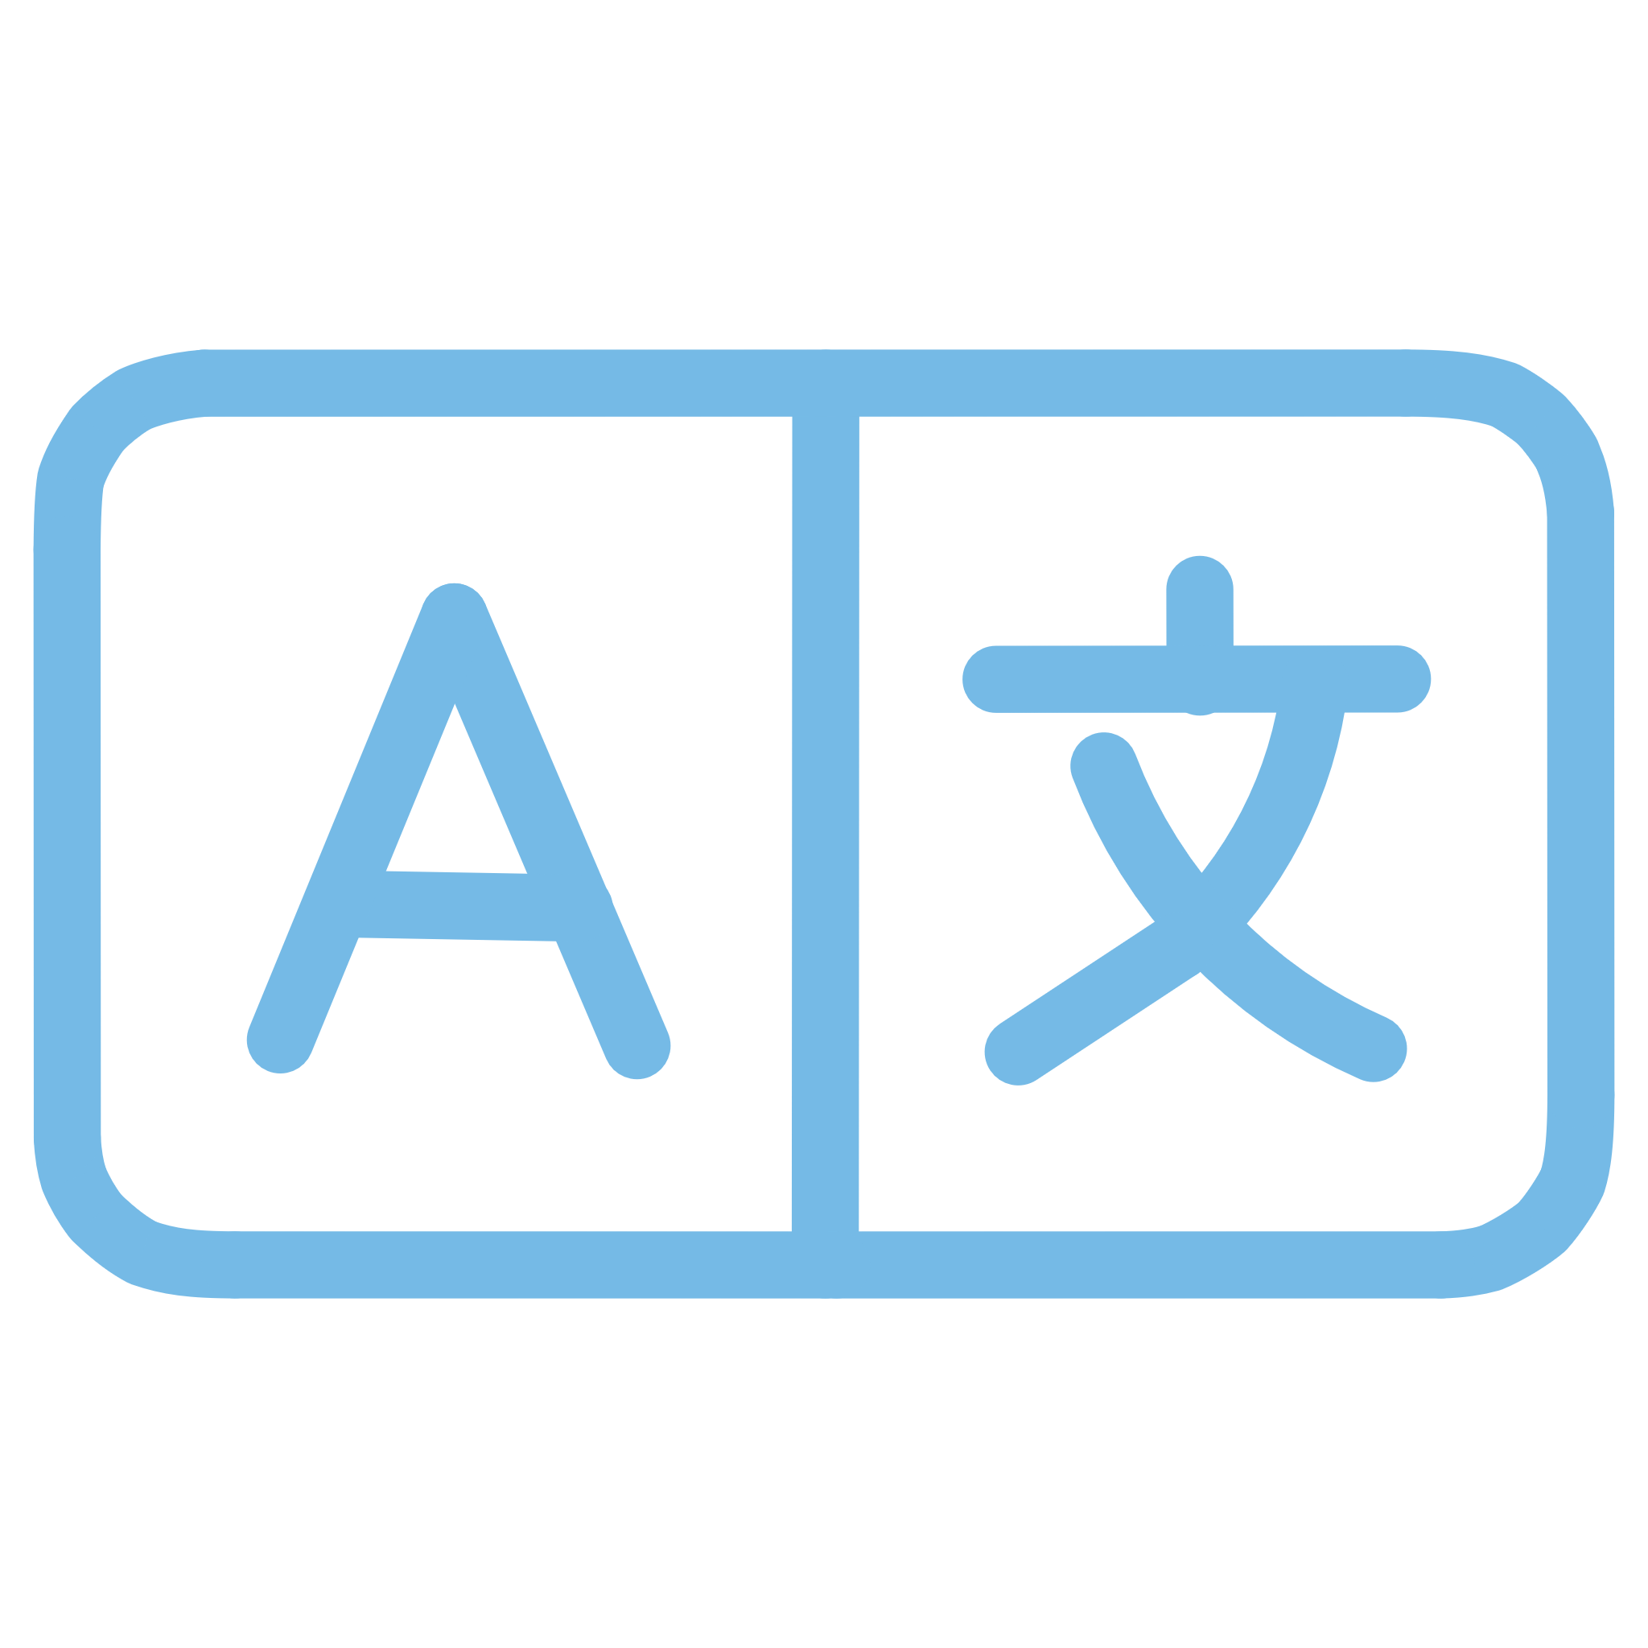





Noida Institute of Engineering and Technology | 2026
Technologies Used
Python
Streamlit
Core programming language
Interactive dashboard framework
TensorFlow/Keras
Pandas & NumPy
LSTM model implementation
Data manipulation and processing
Plotly
yFinance
Interactive visualizations
Live data API integration

Slide 7






Noida Institute of Engineering and Technology | 2026
System Architecture
Data Input
CSV / Live API
Preprocessing
Data cleaning
Feature Engineering
Technical indicators
LSTM Training
Model learning
Prediction
Signal generation
Dashboard
Visualization

Slide 8






Noida Institute of Engineering and Technology | 2026
Data Processing Pipeline
Data Cleaning
Prepare stock data
Handle Missing Values
Fill gaps in data
Date Formatting
Standardize dates
Normalization
MinMaxScaler
Time-Series
60-day sequences

Slide 9

Noida Institute of Engineering and Technology | 2026
Technical Indicators Used
1
2
3
Moving Average
Exponential MA
Relative Strength Index
MA50, MA200 for trend analysis
EMA20 for faster signals
RSI for momentum measurement
4
5
Bollinger Bands
MACD Indicator
Volatility indicators
Trend confirmation tool
These indicators help in trend analysis and decision making

Slide 10

Noida Institute of Engineering and Technology | 2026
Deep Learning Model: LSTM
What is LSTM?
Long Short-Term Memory networks handle time-series data and learn patterns from past stock prices
Model Architecture
2 LSTM Layers
Dense Output Layer
Adam Optimizer
MSE Loss Function

Slide 11
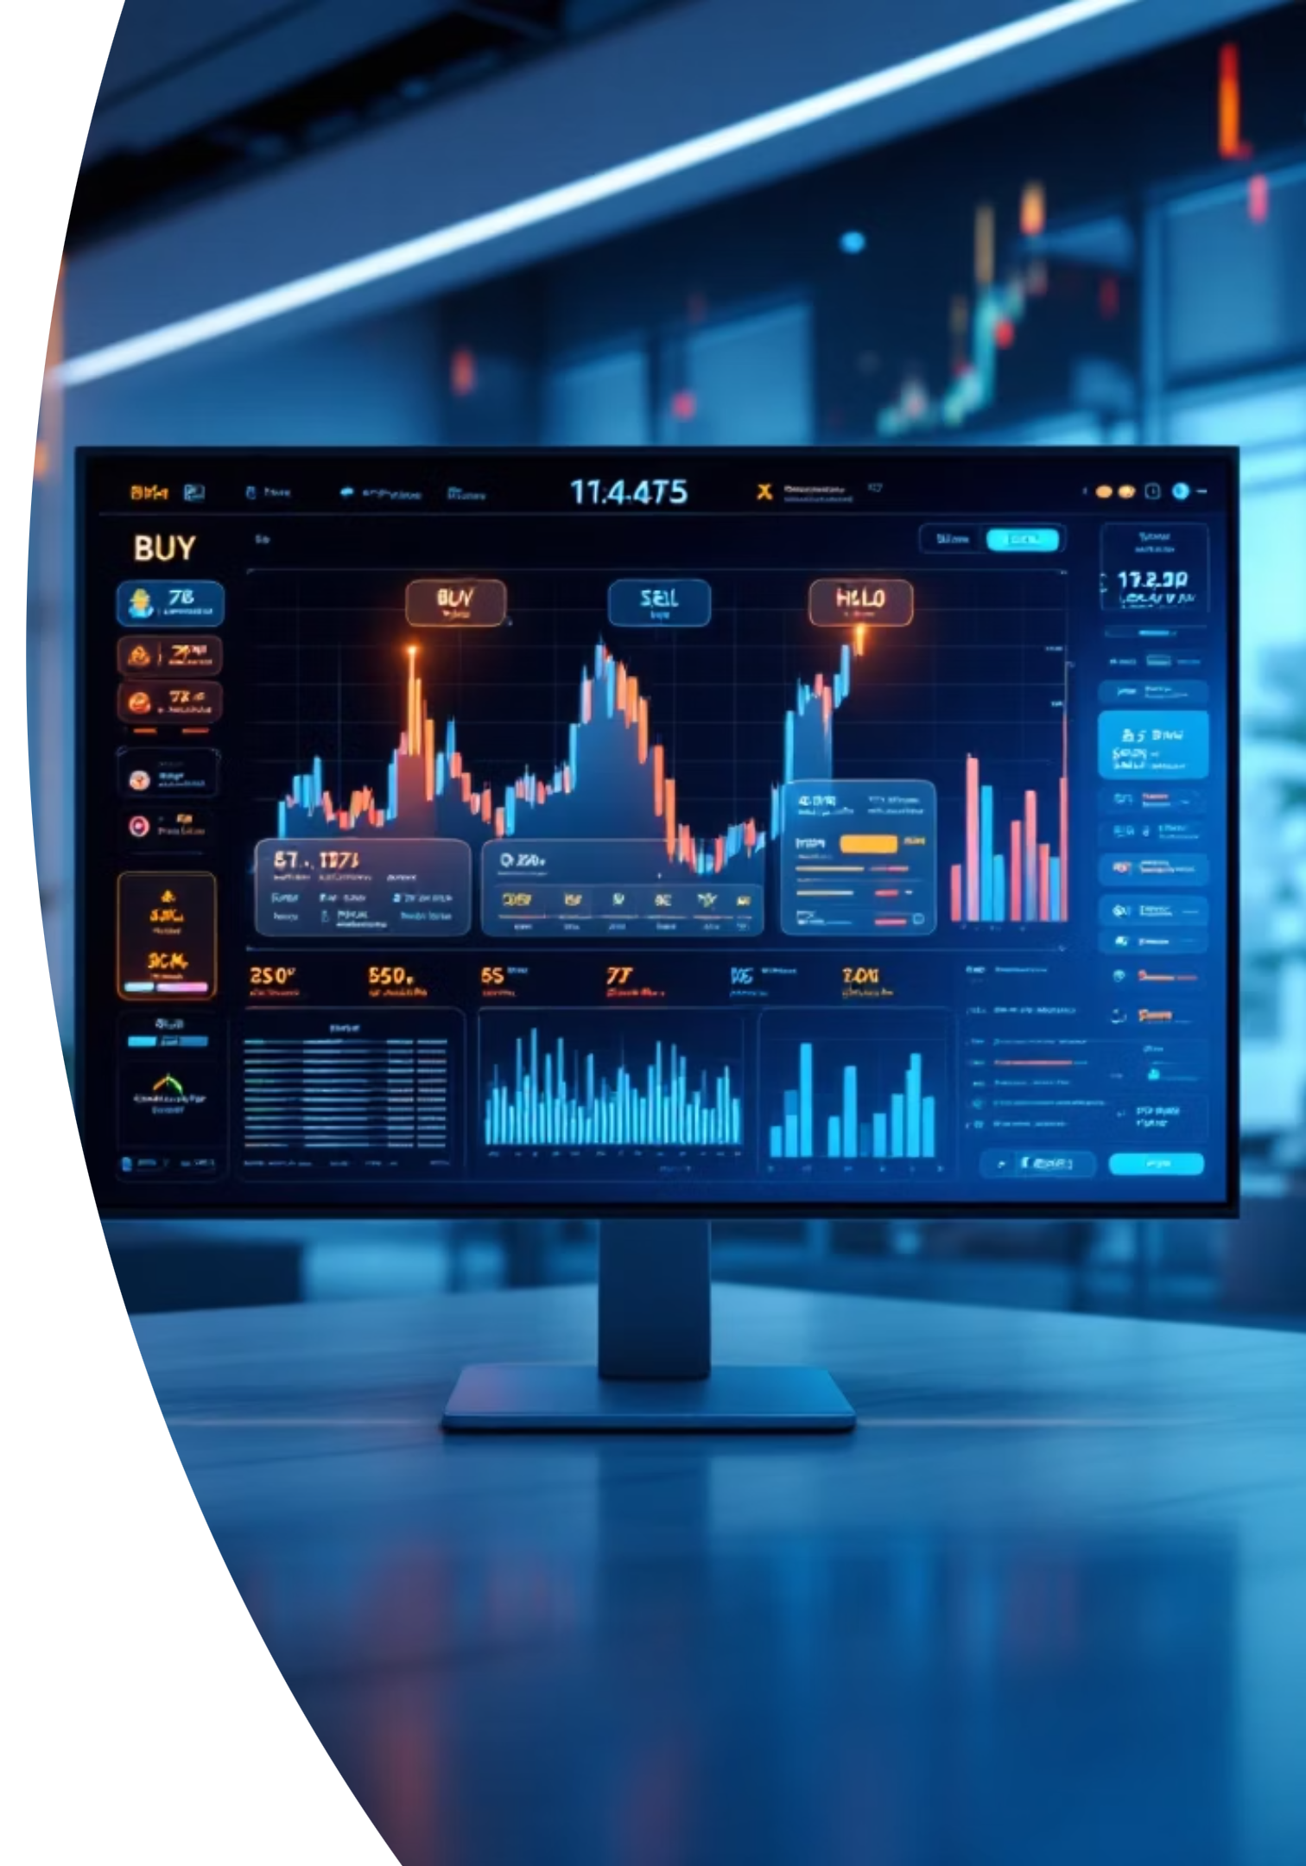
Noida Institute of Engineering and Technology | 2026
AI Decision Logic
BUY Signal
SELL Signal
Price > MA50 AND RSI < 70
Price < MA50 AND RSI > 30
HOLD Signal
Otherwise condition
System combines technical indicators with AI predictions to generate trading signals

Slide 12
Noida Institute of Engineering and Technology | 2026
Thank You

